Slide 1
ASET
Predict time to incapacitation
Calculate the available egress time

Slide 2
Historic Fire
DuPont Plaza Hotel

Slide 3
ASET
Meaning of acronym
Times included

Slide 4
Fire Growth
t²
Based on reaching 1000 Btu/s (1055 kW)
Slow: 0.28*10⁻² Btu/s³, τ=600s
Medium: 1.11*10⁻² Btu/s³, τ=300s
Fast: 4.44*10⁻² Btu/s³, τ=150 s
Ultrafast: 17.78*10⁻² Btu/s³, τ=75 s
Notes:
4

Slide 5
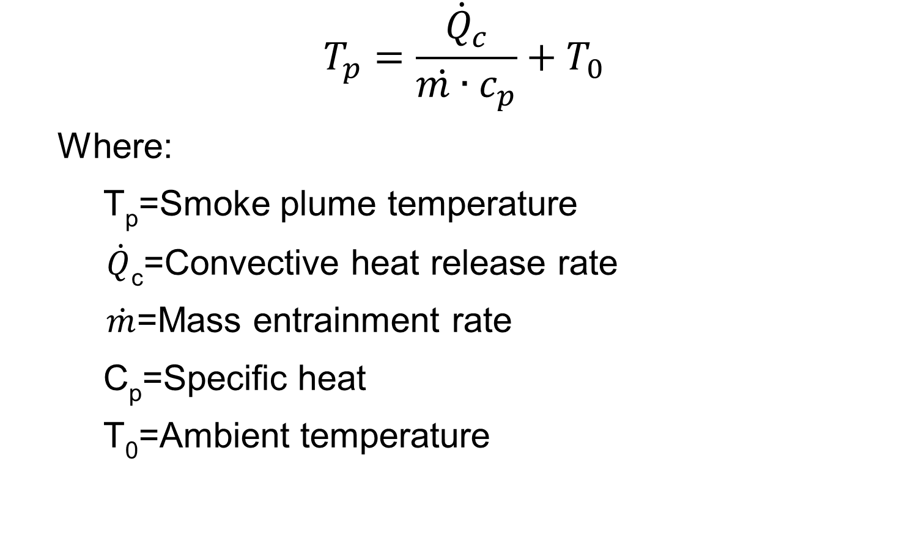
Smoke Plume
$$T_{p}=\frac{{\dot{Q}}_{c}}{\dot{m∙}c_{p}}+T_{0}$$
Where:
T_{p}=Smoke plume temperature
$\dot{Q}$_{c}=Convective heat release rate
$\dot{m}$=Mass entrainment rate
C_{p}=Specific heat
T₀=Ambient temperature
Notes:
5

Slide 6
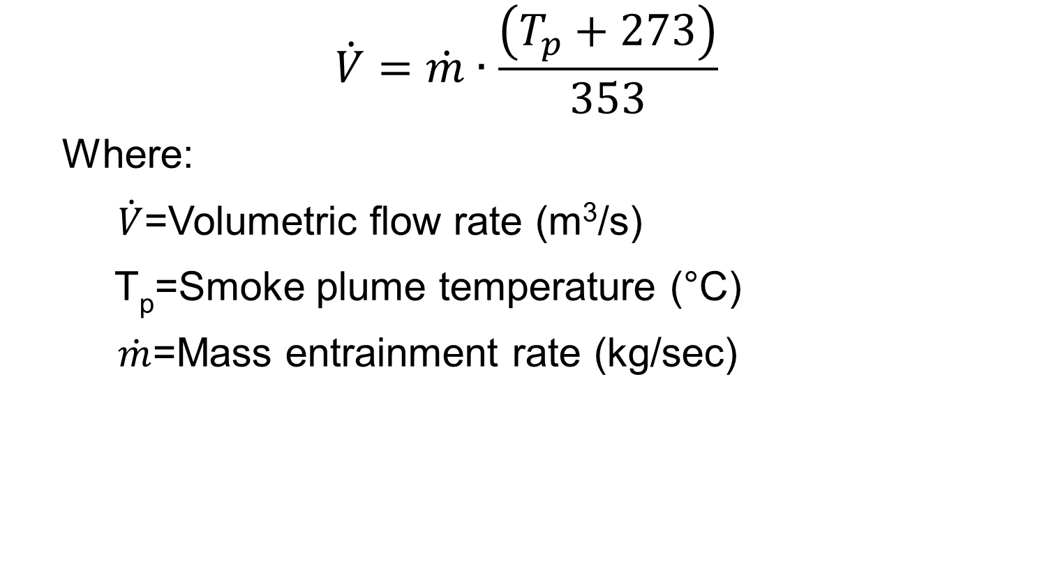
Smoke Plume
$$\dot{V}=\dot{m}∙\frac{\left(T_{p}+273\right)}{353}$$
Where:
$\dot{V}$=Volumetric flow rate (m³/s)
T_{p}=Smoke plume temperature (°C)
$\dot{m}$=Mass entrainment rate (kg/sec)
Notes:
6

Slide 7
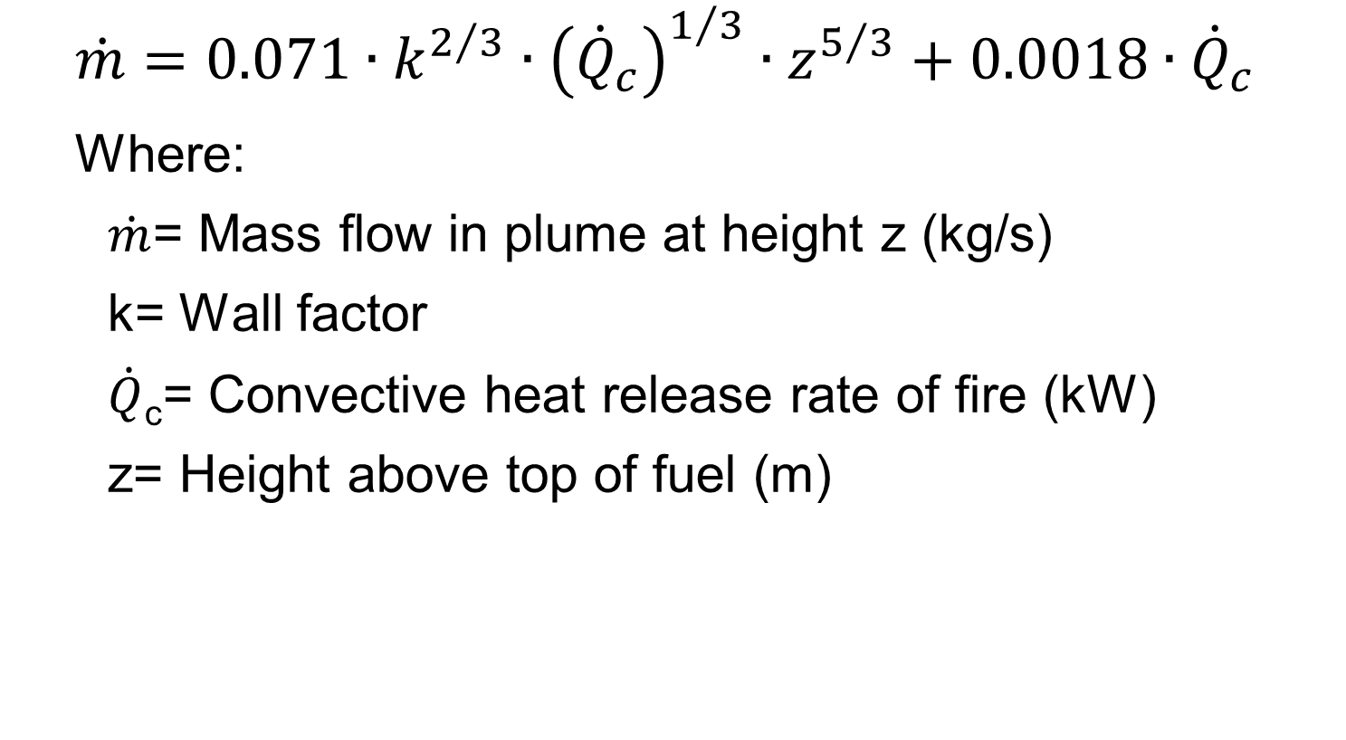
Smoke Production
$$\dot{m}=0.071∙k^{2/3}∙{\left({\dot{Q}}_{c}\right)}^{1/3}∙z^{5/3}+0.0018∙{\dot{Q}}_{c}$$
Where:
$\dot{m}$= Mass flow in plume at height z (kg/s)
k= Wall factor
$\dot{Q}$_{c}= Convective heat release rate of fire (kW)
z= Height above top of fuel (m)

Slide 8
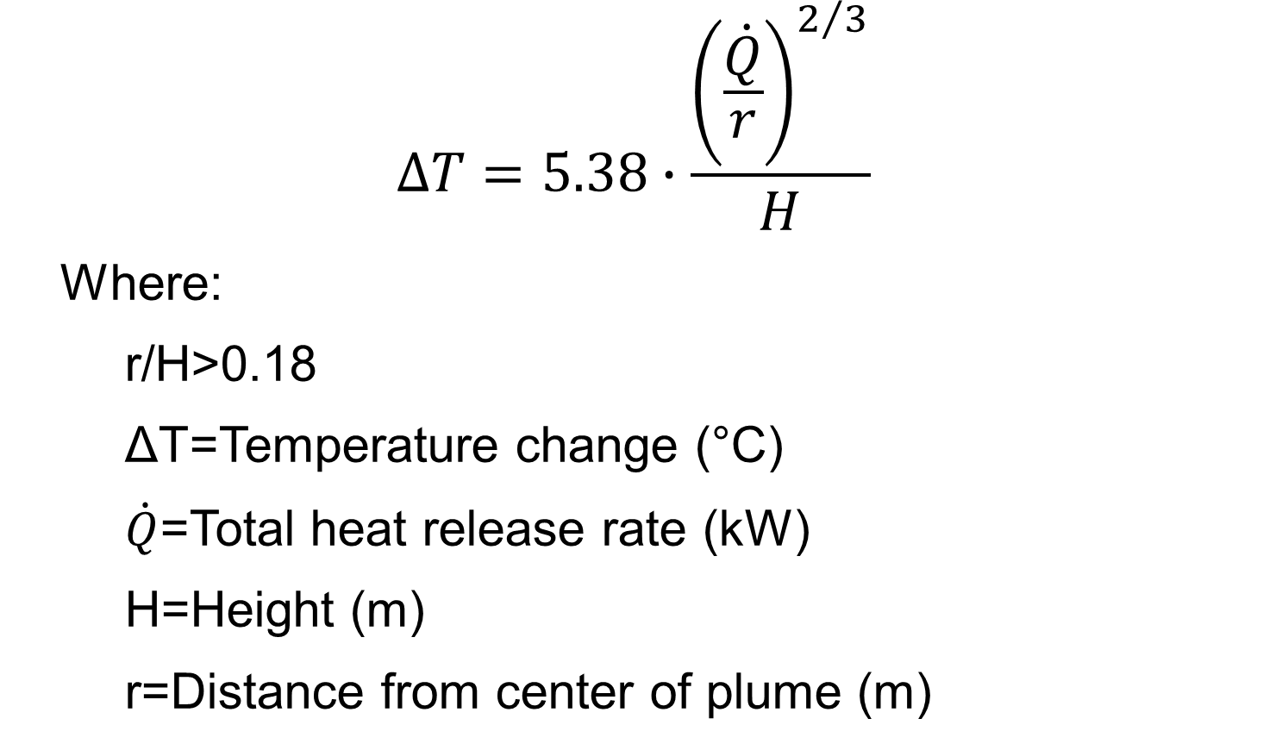
Ceiling Jet
$$∆T=5.38∙\frac{{\left(\frac{\dot{Q}}{r}\right)}^{2/3}}{H}$$
Where:
r/H>0.18
ΔT=Temperature change (°C)
$\dot{Q}$=Total heat release rate (kW)
H=Height (m)
r=Distance from center of plume (m)
Notes:
8

Slide 9
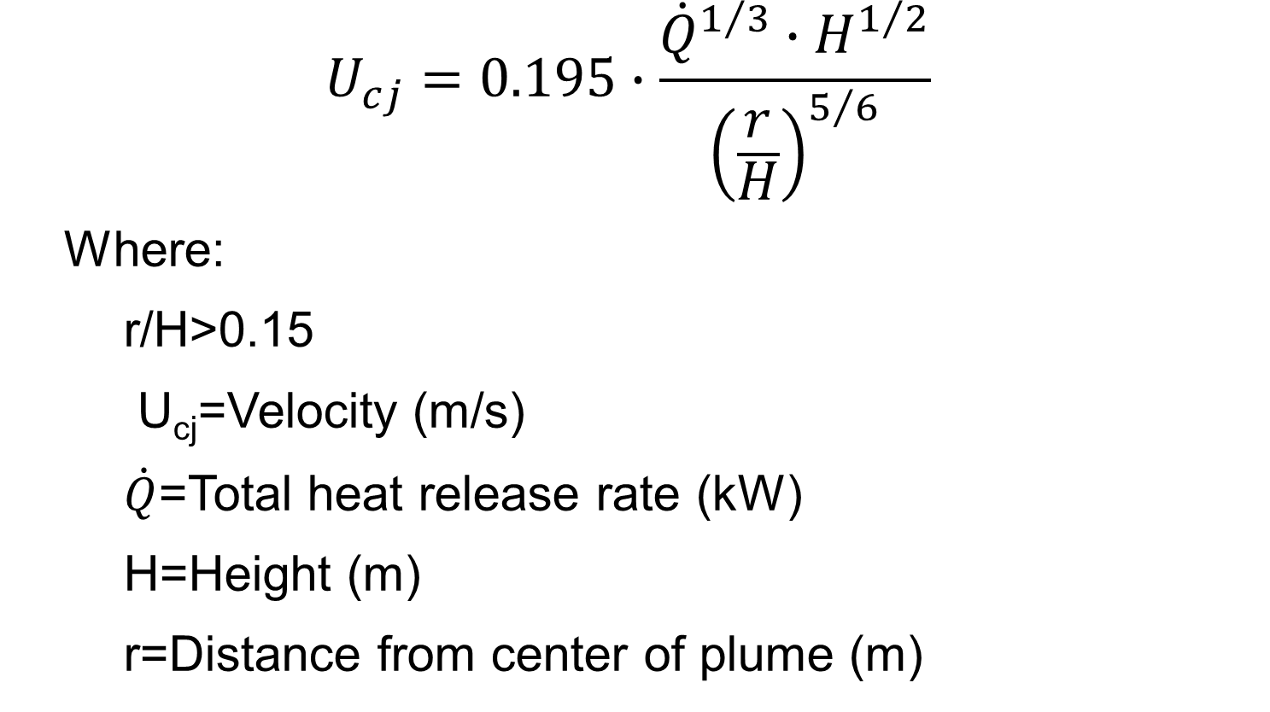
Ceiling Jet
$$U_{cj}=0.195∙\frac{{\dot{Q}}^{1/3}∙H^{1/2}}{{\left(\frac{r}{H}\right)}^{5/6}}$$
Where:
r/H>0.15
U_{cj}=Velocity (m/s)
$\dot{Q}$=Total heat release rate (kW)
H=Height (m)
r=Distance from center of plume (m)
Notes:
9

Slide 10
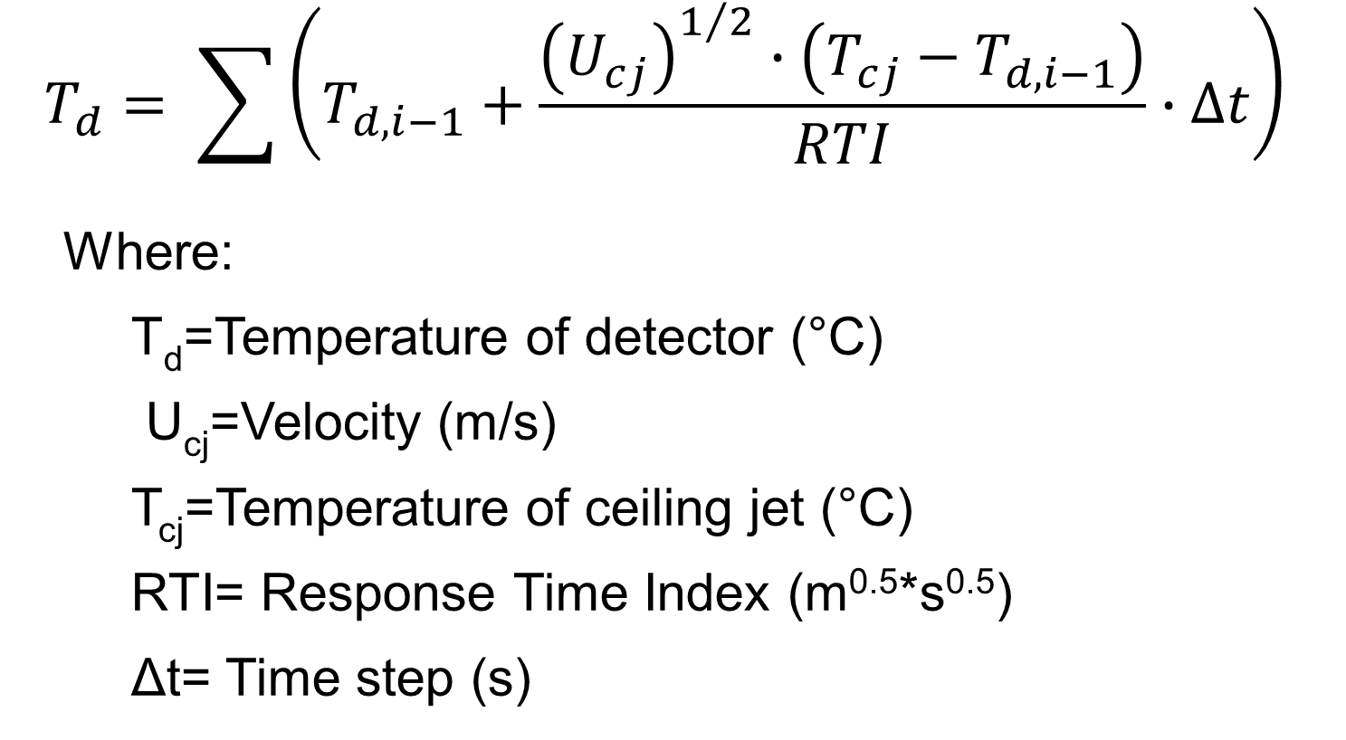
Activation Times
$$T_{d}= \sum{\left(T_{d,i−1}+\frac{{\left(U_{cj}\right)}^{1/2}∙\left(T_{cj}−T_{d,i−1}\right)}{RTI}∙∆t\right)}$$
Where:
T_{d}=Temperature of detector (°C)
U_{cj}=Velocity (m/s)
T_{cj}=Temperature of ceiling jet (°C)
RTI= Response Time Index (m^{0.5}*s^{0.5})
Δt= Time step (s)
Notes:
10

Slide 11
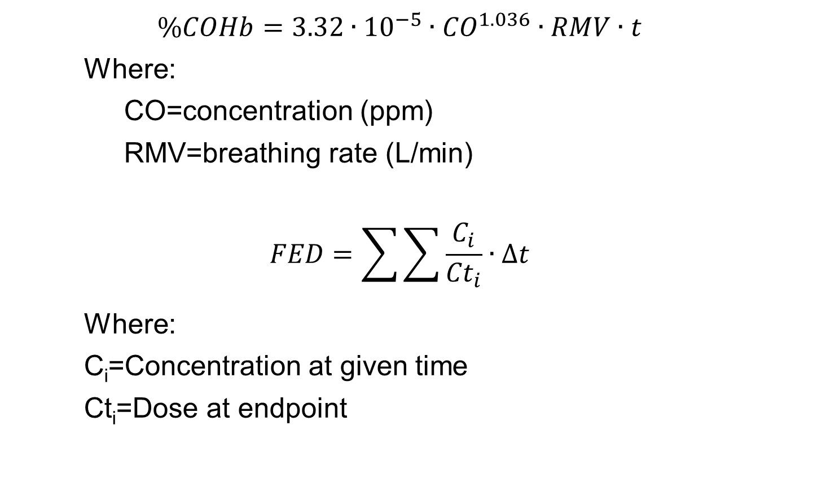
Smoke
$$\%COHb=3.32∙{10}^{−5}∙{CO}^{1.036}∙RMV∙t$$
Where:
CO=concentration (ppm)
RMV=breathing rate (L/min)
$$FED=\sum{\sum{\frac{C_{i}}{{Ct}_{i}}∙∆t}}$$
Where:
C_{i}=Concentration at given time
Ct_{i}=Dose at endpoint
Notes:
11

Slide 12
Tenability
F_{IN}=((F_{ICO}+F_{ICN}+FLC_{irr})*VCO₂+FED_{IO})
See 3-130 or 6-18 in NFPA Handbook for details
Irritants can cause incapacitation
See FEC equation (6-24)
Notes:
12

Slide 13
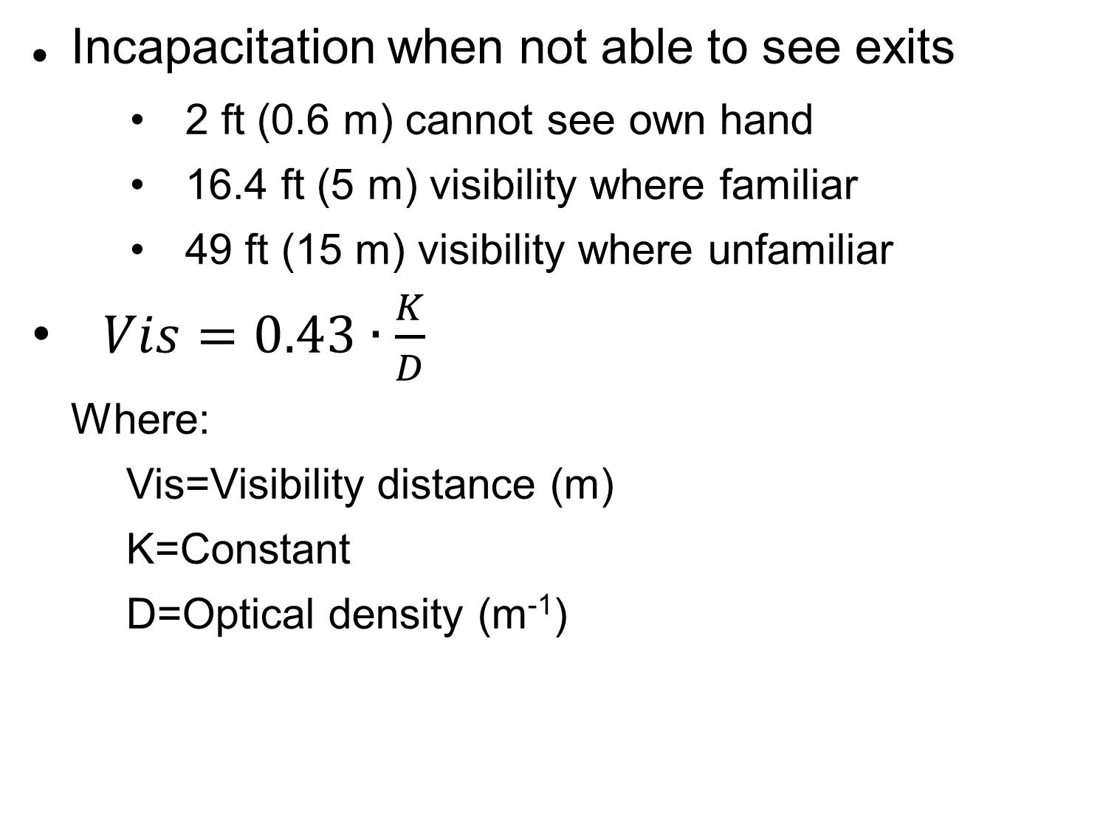
Visibility
Incapacitation when not able to see exits
2 ft (0.6 m) cannot see own hand
16.4 ft (5 m) visibility where familiar
49 ft (15 m) visibility where unfamiliar
$Vis=0.43∙\frac{K}{D}$
Where:
Vis=Visibility distance (m)
K=Constant
D=Optical density (m⁻¹)
Notes:
13

Slide 14
Heat
Skin burns
Skin temperature 113 °F (44.8 °C)
2.5 kW/m²
392 °F (200 °C)
Respiratory burns
140 °F (60 °C)
Hyperthermia
248 °F (121 °C)
150 °F (66 °C)
Notes:
14

Slide 15
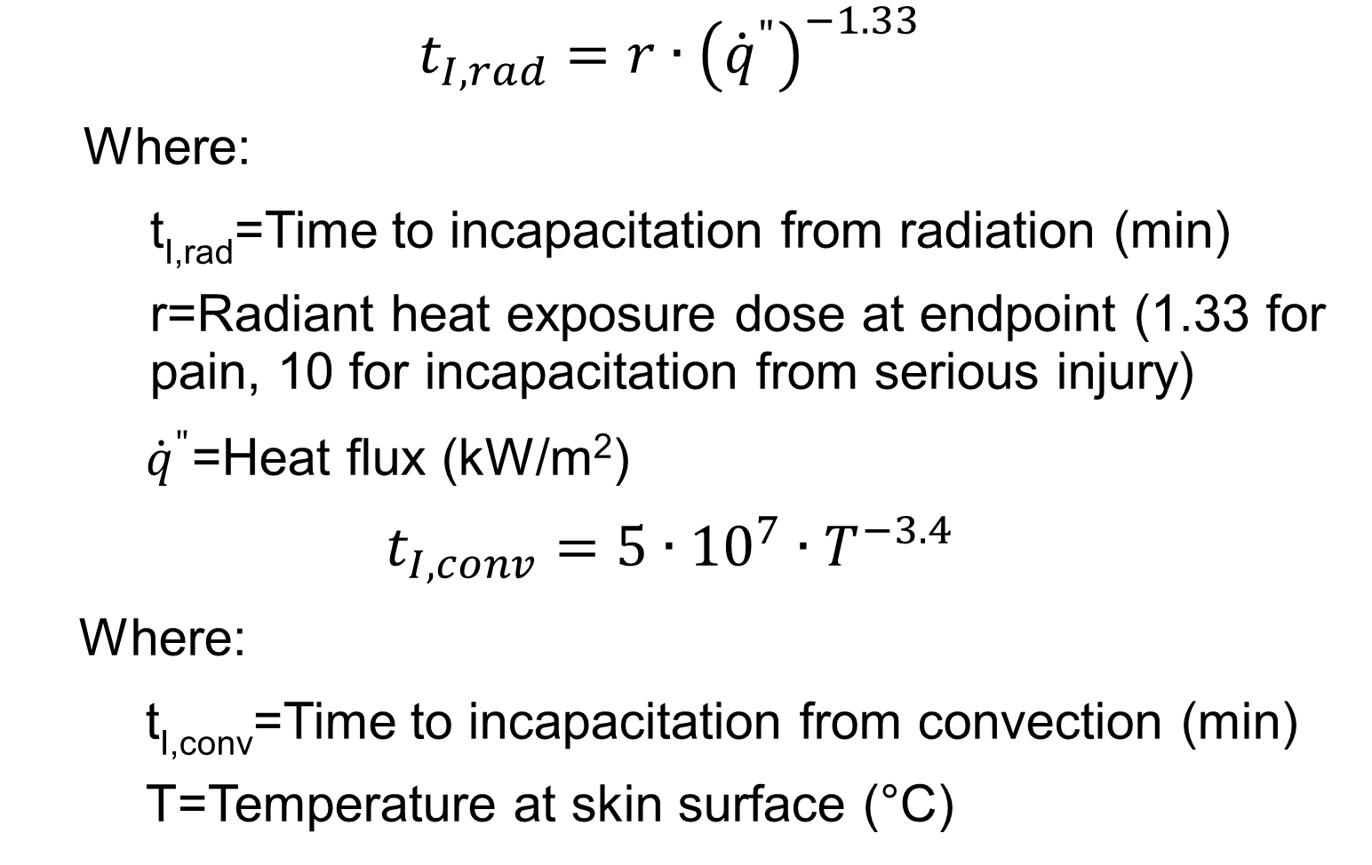
Heat
$$t_{I,rad}=r∙{\left({\dot{q}}^{"}\right)}^{−1.33}$$
Where:
t_{I,rad}=Time to incapacitation from radiation (min)
r=Radiant heat exposure dose at endpoint (1.33 for pain, 10 for incapacitation from serious injury)
${\dot{q}}^{"}$=Heat flux (kW/m²)
$$t_{I,conv}=5∙{10}^{7}∙T^{−3.4}$$
Where:
t_{I,conv}=Time to incapacitation from convection (min)
T=Temperature at skin surface (°C)
Notes:
15

